Slide 1

Final Project as Data Scientist
By Luthfi Adnan Rahmantyo

Slide 2

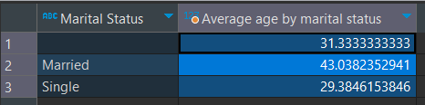
Exploratory data analysis in DBeaver
It can be seen from the data that the average age of the "Martial Status" column varies, Undefined by 31.33; Married by 43.03; Single by 29.38.
Average Age by Marital Status

Slide 3

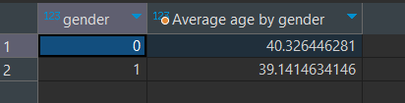
Exploratory data analysis in DBeaver
It can be seen from the data on the side that the average age of the "Gender" column varies for the male gender type of 40.32 and for women of 39.14.
Average Age by Gender

Slide 4
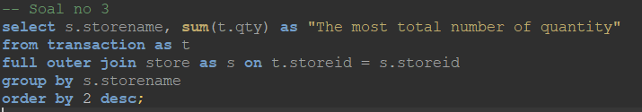
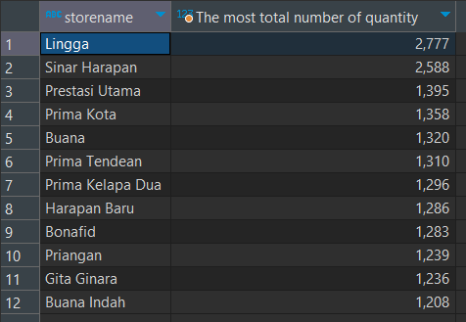
Exploratory data analysis in DBeaver
It can be seen from the data that the stores with the names "Lingga and Sinar Harapan" have total sales above 2000 and rank 3 - 12 have average sales of 1000.
The most total number of quantity

Slide 5
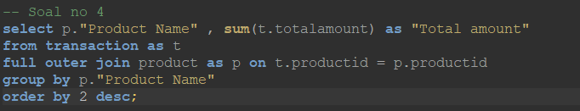
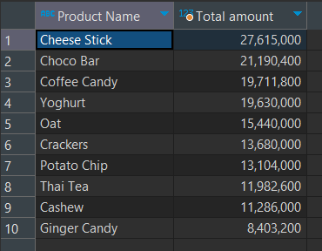
Exploratory data analysis in DBeaver
Cheese sticks and Choco bars have the highest number of sales that exceed 20 million, other products have sales below 20 million.
Total Amount

Slide 6
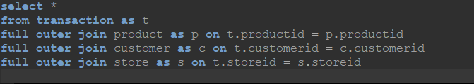
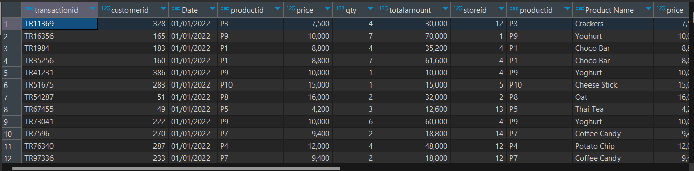
Merge Data for Explanation in Tableau

Slide 7
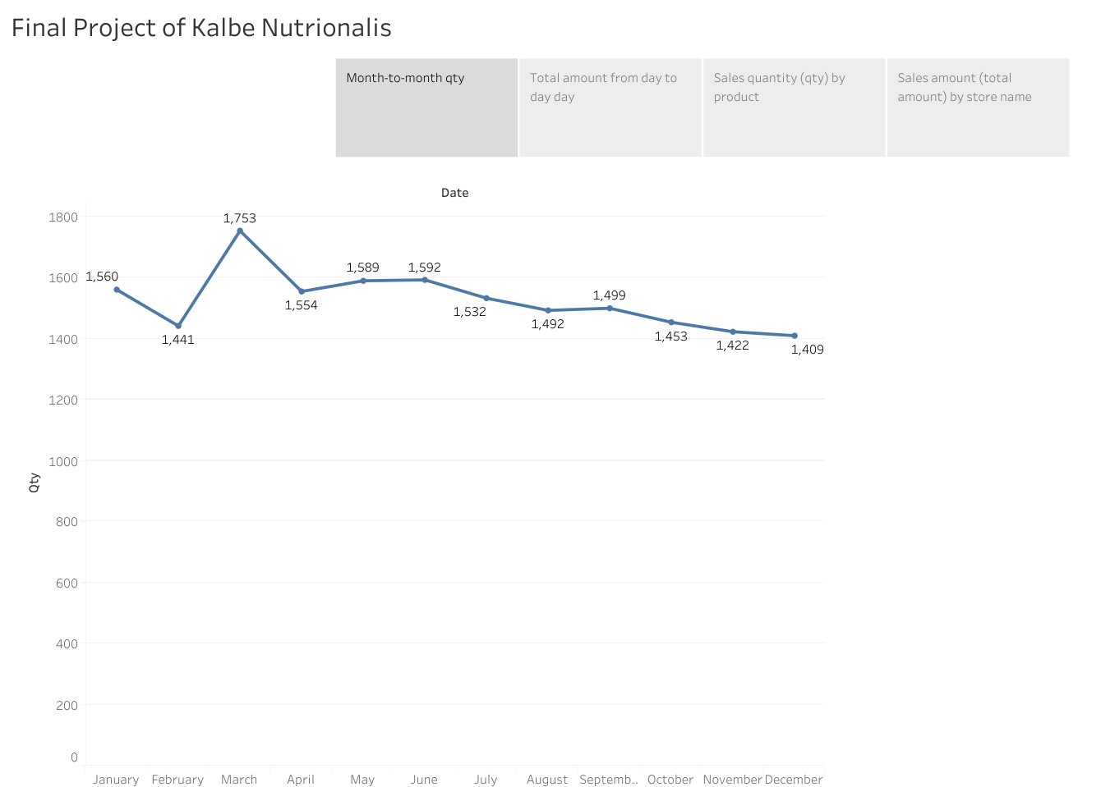
Data Ingestion in Tableau Public
It can be seen from the table that the sales data has increased significantly from February to March and is the highest number of sales, March - December the number of sales has decreased very singnificant. The number of sales in December was the lowest sales for one year.

Slide 8
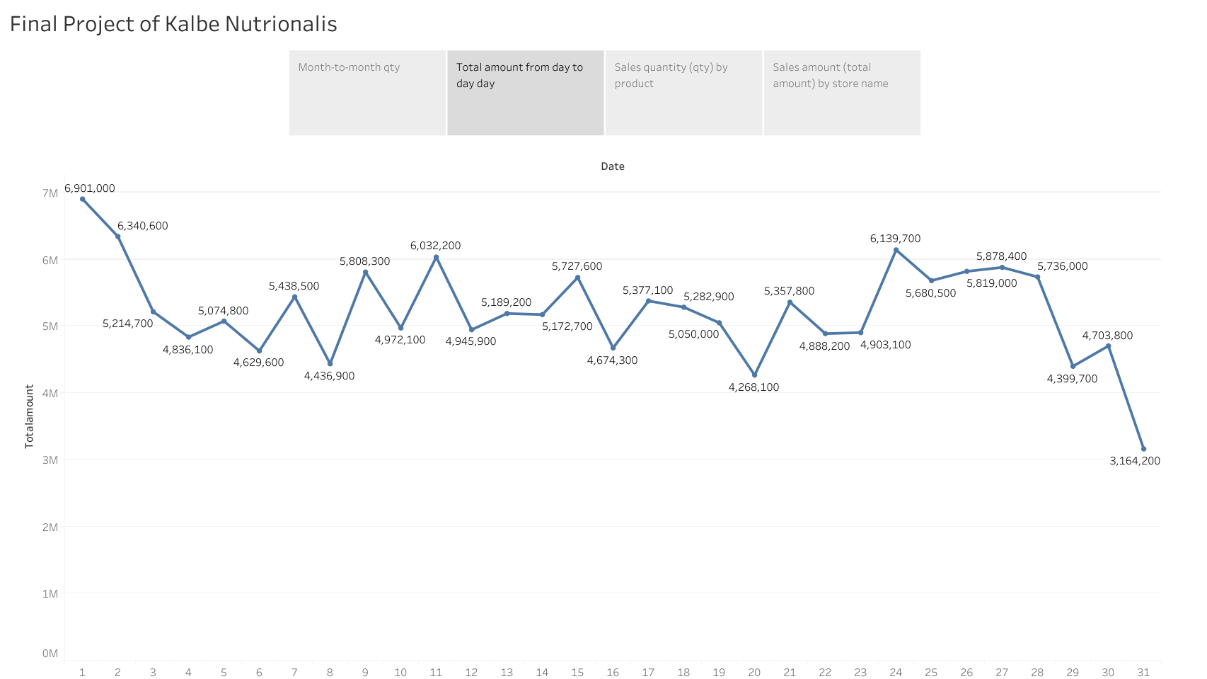
Data Ingestion in Tableau Public
The number of sales by days varies greatly, with the highest number of sales falling on day 1 at 6,901,00 and the smallest number falling on the last day of the last year at 3,164,200.

Slide 9
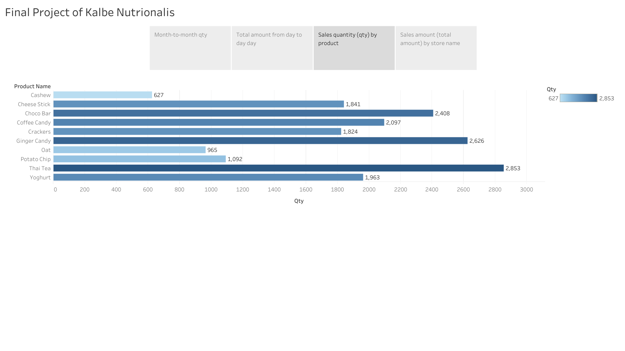
Data Ingestion in Tableau Public
Thai tea, ginger candy, and choco bar are the top 3 in sales, the possibility of these 3 products being the top 3 is due to the tendency of Indonesians to favor sweet snacks and sweet foods/drinks.

Slide 10
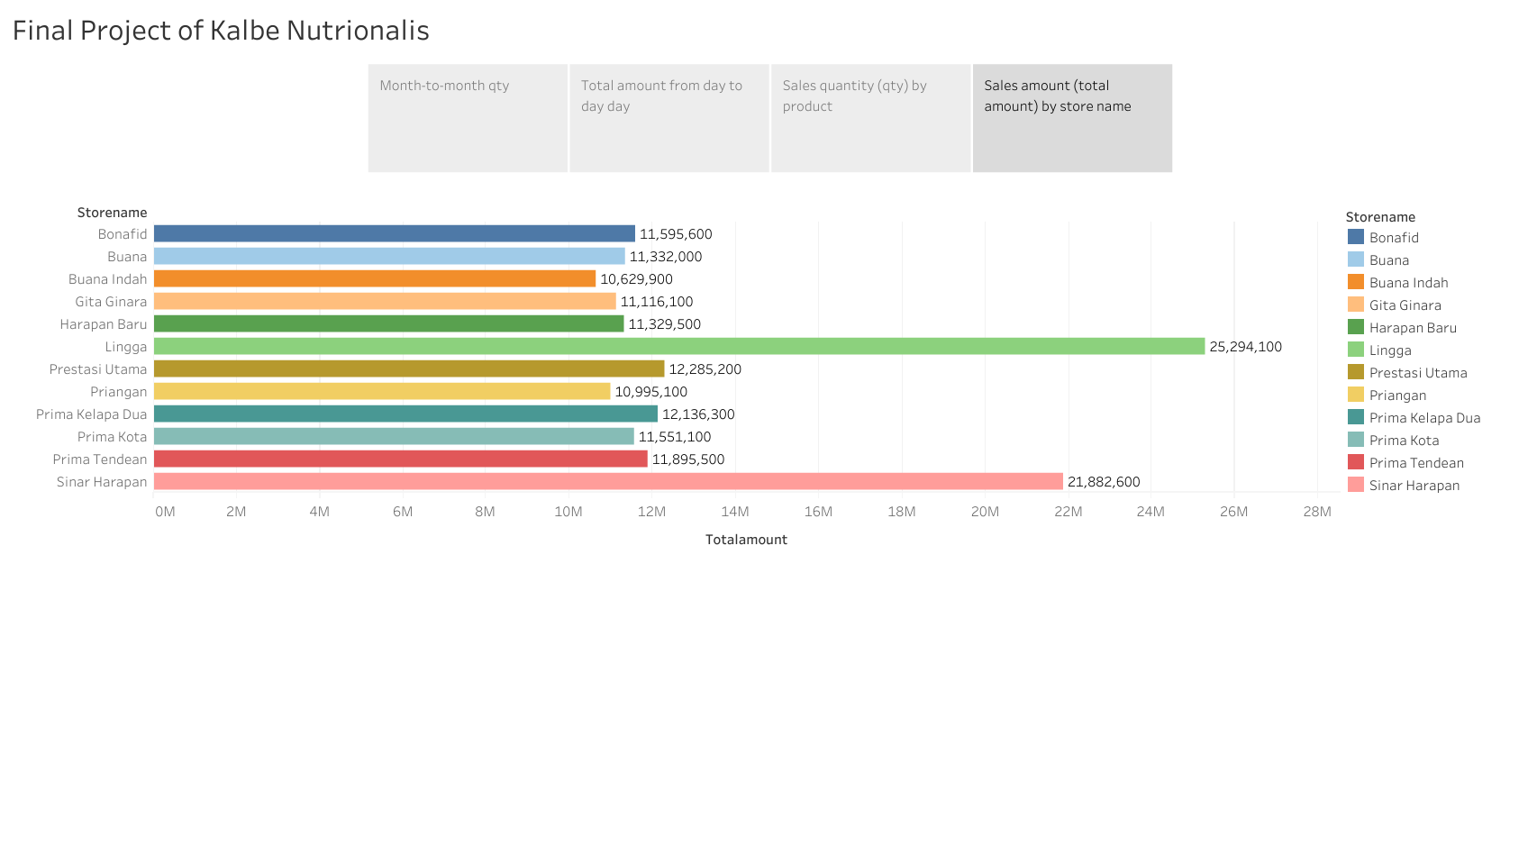
Data Ingestion in Tableau Public
The store with the name Harapan Baru is ranked first with total sales above 25 million, followed by took Sinar Harapan with total sales above 20 million, and followed by several other stores that have total transactions ranging from 10-12 million in one year.

Slide 11
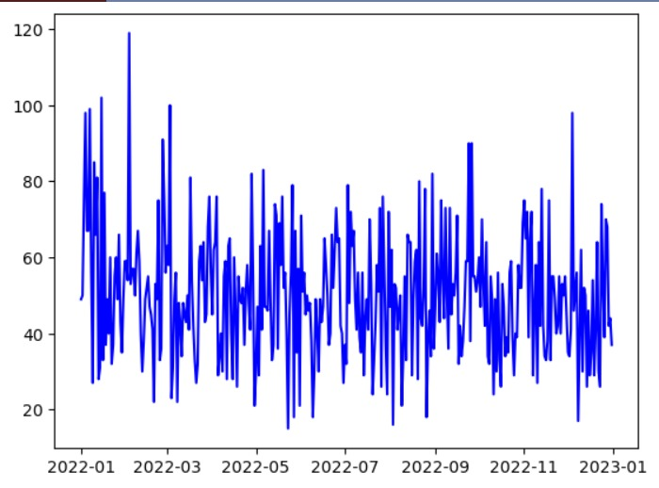
Machine Learning Regression (Time Series)

Slide 12
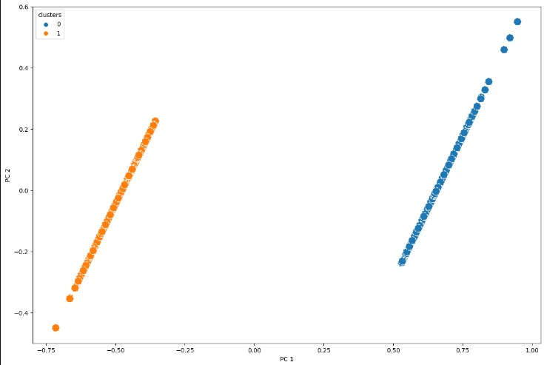
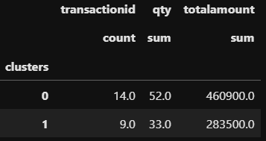
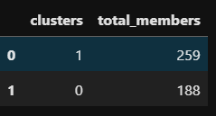
Machine Learning Clustering

Slide 13
Link Video Presentation
https://drive.google.com/file/d/14A_Bamf-ljpdqK9zdpoQ9241QEMrJuE0/view?usp=sharing
Link Github: https://github.com/Lunanr/FinalProjectKalbeNutrionals

